Slide 1
Chapter 3 (beginning-page 82)
The Relational Database Model

Slide 2
Database Design
To build a database to support business applications:
  Must first understand business (rules/processes)
  Exactly what data to store
  How various data elements are related, and
  How long data needs to be stored and the amount of data expected to be stored
Process requires two basic steps:
  Design a Conceptual Model
  Design an Implementation Model
Relational database model enables logical representation of the data and its relationships
  Logical simplicity yields simple and effective database design methodologies
  The logical view is facilitated by the creation of data relationships based on a logical construct called a relation
Notes:
v

Slide 3
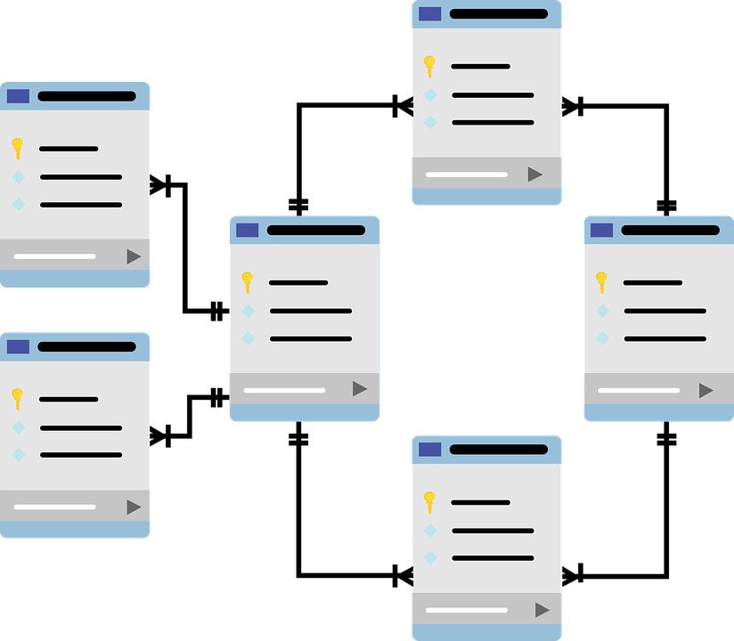
Relational Database
A relational database data in a collection of tables that are connected to each other. Each table corresponds to a real-world object.

Slide 4
Database Design
User views
of data.
Conceptual
data model.
Implementation
(relational)
data model.
Physical
data
storage.
Entity Relationship diagram that shows business entities, relationships, and rules.
List of nicely-behaved tables. Use data normalization to derive the list.
Indexes and storage methods to improve performance.

Slide 5
Entity and Attribute
Entity: Something in the real world that we wish to describe or track.
  It can be a person, place, thing, or event about which we want to record data.
For a banking system: CUSTOMERS, BANK ACCOUNTS, and MORTGAGE LOANS.
For a warehousing system: SUPPLIERS, PARTS, and SHIPMENTS.
Entity Class/Set: Description of a set of entities, which includes its attributes (properties).
Attribute: A characteristic/descriptor of an entity.

Slide 6
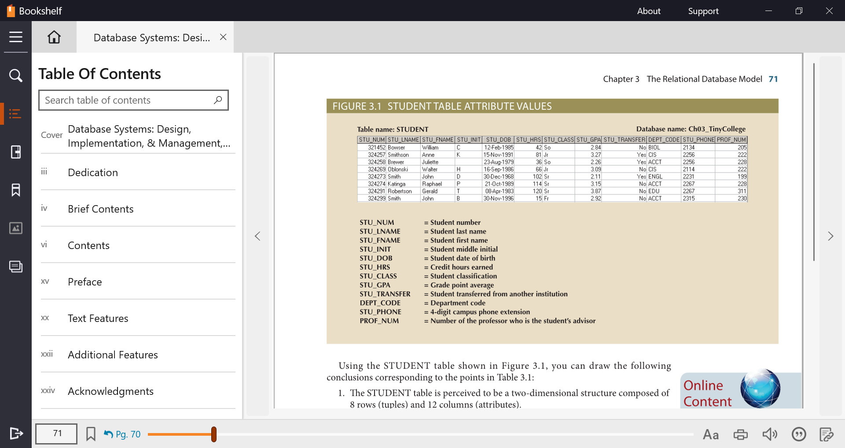

Slide 7
Tables and Their Characteristics
Table 3.1 | Characteristics of a Relational Table
1 | A table is perceived as a two-dimensional structure composed of rows and columns.
2 | Each table row represents a single entity occurrence within the entity set.
3 | Each table column represents an attribute, and each column has a distinct name.
4 | Each intersection of a row and column represents a single data value.
5 | All values in a column must conform to the same data format.
6 | Each column has a specific range of values known as the attribute domain.
7 | The order of the rows and columns is immaterial to the DBMS.
8 | Each table must have an attribute or combination of attributes that uniquely identifies each row.

Slide 8
Primary key
Primary key: attribute or combination of attributes that uniquely identifies a row
Guidelines for primary keys:
  Values not likely to change over lifetime of the table
  Guaranteed to always have values
  Not likely to lose uniqueness in the future
  Minimal set of attributes
  Assignment of values under control of the organization
  Not confidential
  If possible, use an existing attribute for the primary key. But if a suitable attribute doesn’t exist, we can create an artificial primary key (e.g., identity column) that can be used as the primary key.

Slide 9
Composite and Secondary Key
Composite key: combination of attributes that uniquely identifies a row
Secondary key: An attribute or combination of attributes used strictly for data retrieval purposes

Slide 10
Foreign Key
  Foreign key: primary key of one table that has been placed into another table to create a common attribute between the two tables.
  Tables are related to each other using primary key-foreign key relationships.

Slide 11
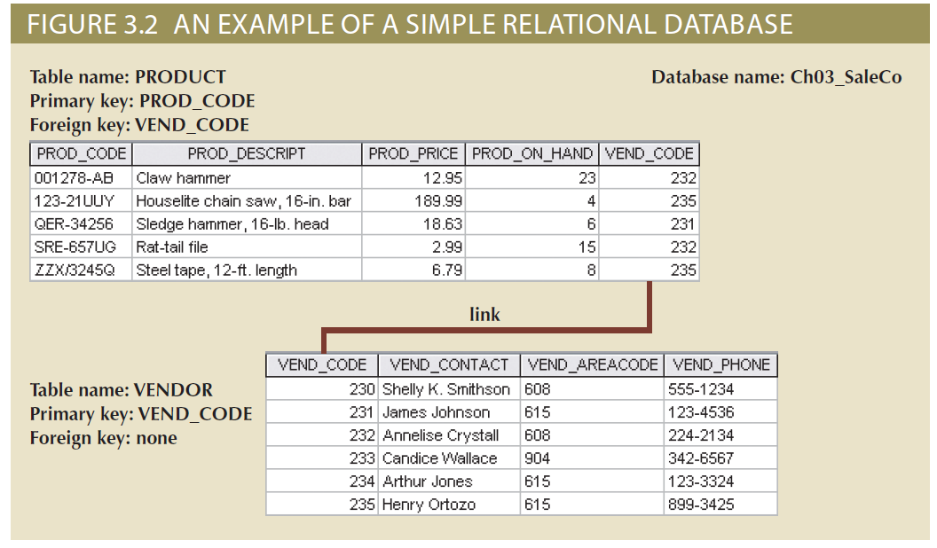
Example

Slide 12
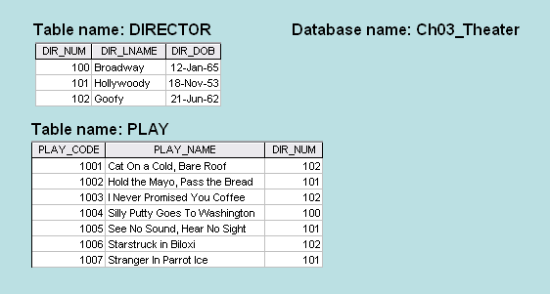
Describe the primary key-foreign key relationship between DIRECTOR and PLAY Tables

Slide 13
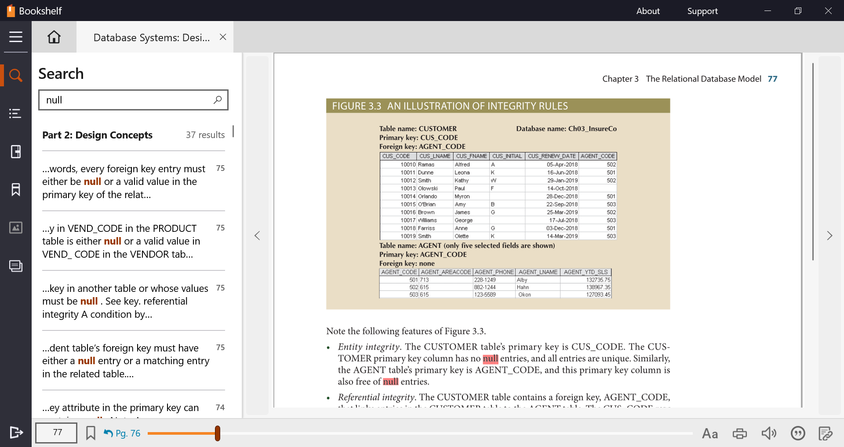
Null Values
  Null: absence of any data value

Slide 14
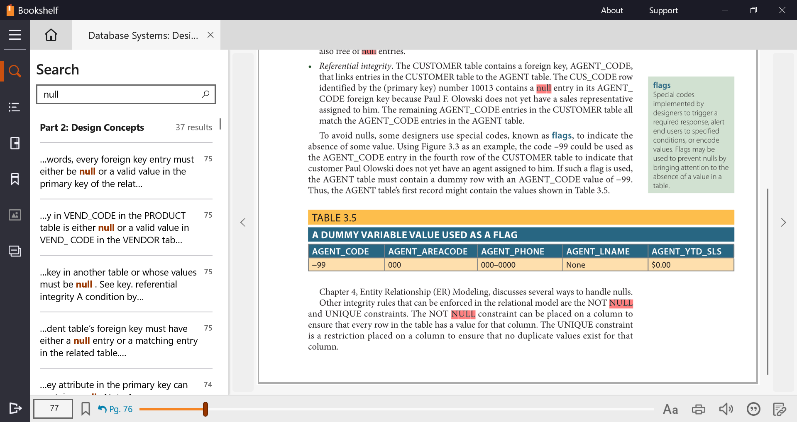
Null Values
  Null: absence of any data value
Ways to handle nulls
  Flags
    Special codes used to indicate the absence of some value
  Constraints
    NOT NULL constraint: placed on a column to ensure that every row in the table has a value for that column

Slide 15
Entity Integrity
  All primary key entries are unique
  Primary key can not contain null values

Slide 16
Referential Integrity
Referential integrity means that the relationships between tables are maintained correctly.
This means that all the non-null foreign key values in a table must have matching primary key values in the related table.
When we define foreign key constraints, we can specify how referential integrity is enforced when a row is deleted from the primary key table or when the value of the primary key of a row is changed.
If referential integrity isn’t enforced and a row is deleted from the primary key table that has related rows in the foreign key table, the rows in the foreign key table are said to be orphaned.
The foreign key attribute (column) should have the same data type as the primary key attribute (column) it is related to.

Slide 17
Few operations that can violate referential integrity
This operation… | Violates referential integrity if…..
Delete a row from the primary key table | The foreign key table contains one or more rows related to the deleted row
Insert a row in the foreign key table | The foreign key value doesn’t have a matching primary key value in the related table
Update the value of a foreign key | The new foreign key value doesn’t have a matching primary key value in the related table
Update the value of a primary key | The foreign key table contains one or more rows related to the row that’s changed
Most databases support cascading update and delete

Slide 18
Integrity Example
Order
OrdNum Odate CNum …
1173 1-4-09 321
1174 1-5-09 938
1185 1-8-09 337
1190 1-9-09 321
1192 1-9-09 776
Customer
CNum LName Phone …
321 Jones 9983-
337 Sanchez 7738-
938 Carson 8738-

Slide 19
Relational Set Operators
Select (restrict)
  Unary operator that yields a horizontal subset of a table
Project
  Unary operator that yields a vertical subset of a table
Union
  Combines all rows from two tables, excluding duplicate rows
  Union-compatible: tables share the same number of columns, and their corresponding columns share compatible domains
Intersect
  Yields only the rows that appear in both tables
  Tables must be union-compatible to yield valid results

Slide 20
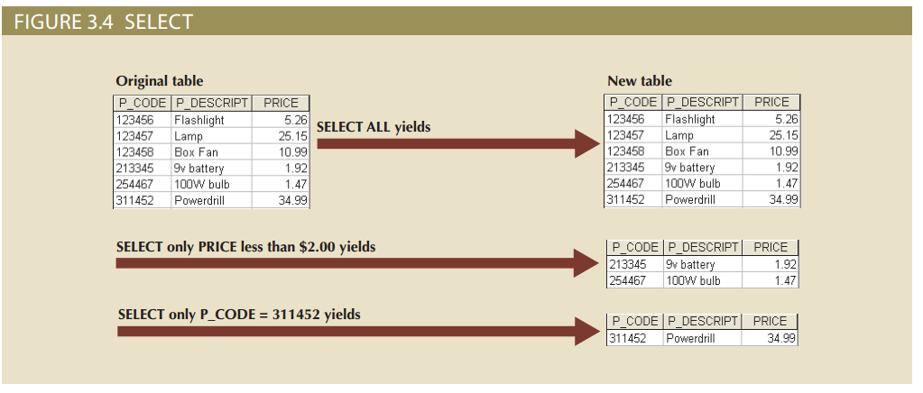
Relational Set Operators

Slide 21
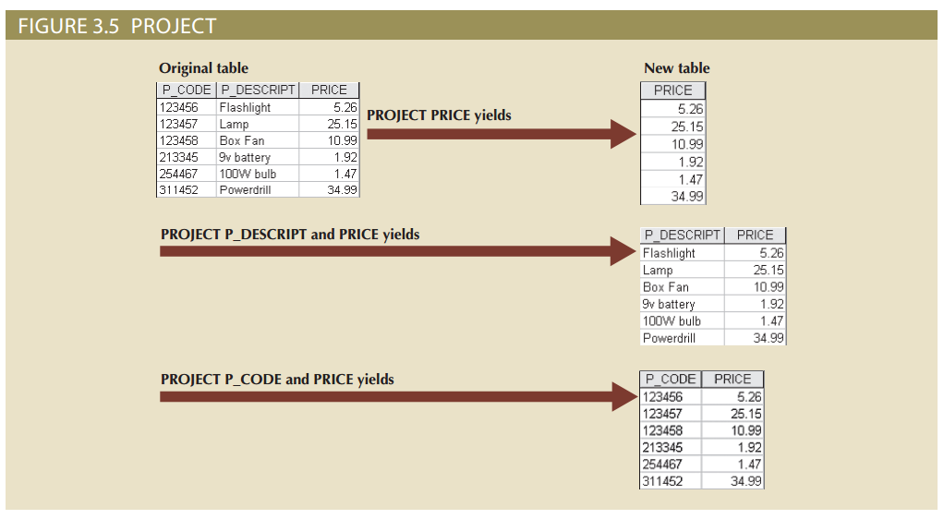
Relational Set Operators

Slide 22
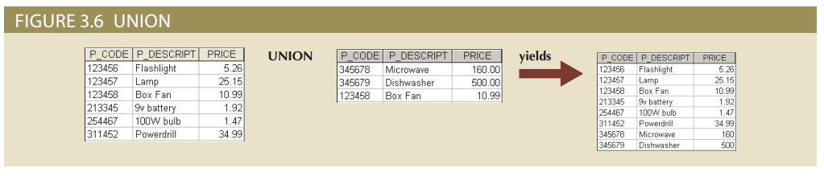
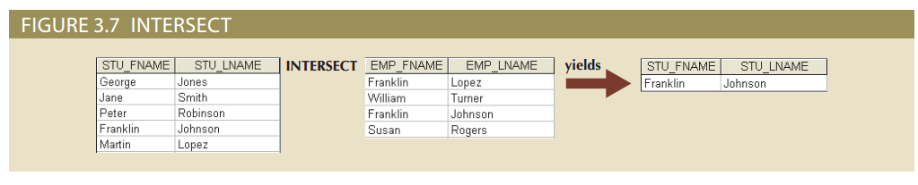
Relational Set Operators

Slide 23
Relational Set Operators
Difference
  Yields all rows in one table that are not found in the other table
  Tables must be union-compatible to yield valid results
Product
  Yields all possible pairs of rows from two tables

Slide 24
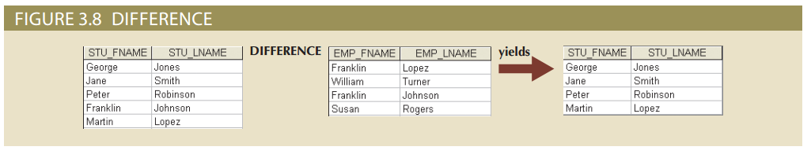
Relational Set Operators

Slide 25
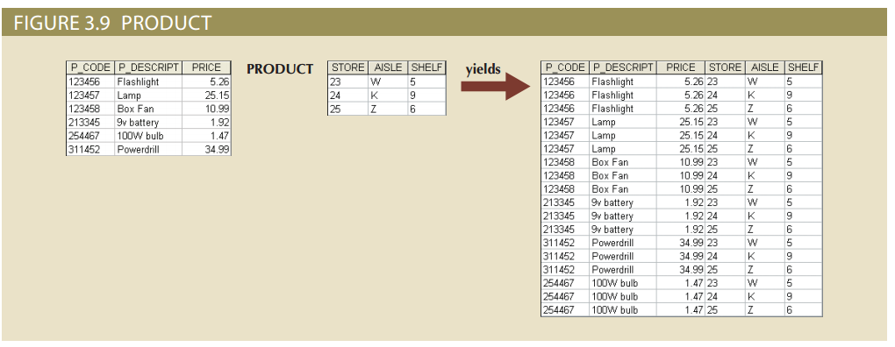
Relational Set Operators

Slide 26
Review Questions
What is the difference between a database and a table?
Why are entity integrity and referential integrity important in a database?

Slide 27
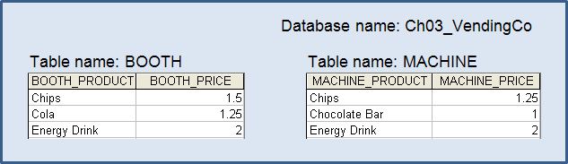
Exercise 3
Perform UNION, INTERSECTION, and DIFFERENCE

